Slide 1
OPTICS ALGORITHM
CLUSTERING ALORITHMS

Slide 2
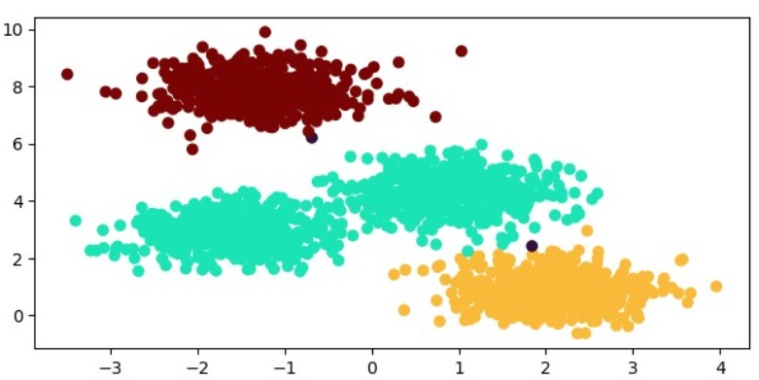
What is OPTICS?
Definition: A clustering algorithm that identifies the density-based clusters in spatial data.
Key Features:
Handles varying densities.
Produces a reachability plot to visualize the clustering structure.
Key Concepts of OPTICS
Reachability Distance: Measures how far a point is from its cluster.
Core Distance: Minimum distance required to reach a certain number of points (minPts).
Ordering: Points are ordered based on their reachability distances.

Slide 3
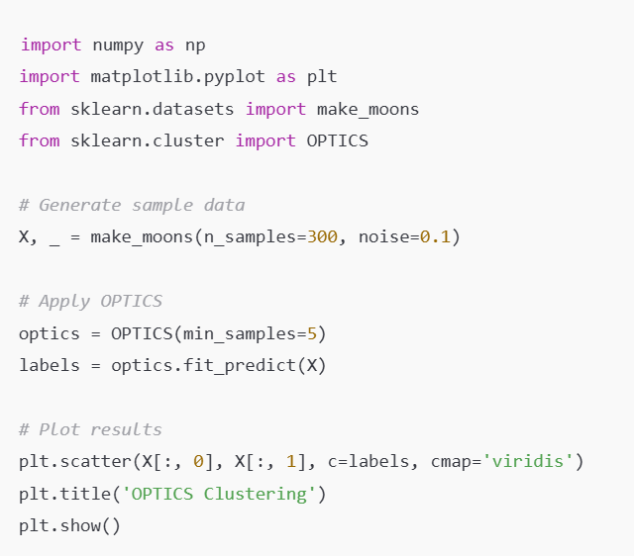
OPTICS in scikit-learn
Examples:

